Slide 1
Mobile Application Development
Assignment 1
Group members
(8669171) Ankit Shah
(8669132) Ashish Jullia
(8680275) Gurdeep Singh
(8638469) Shivam Kochar
Mentor
Dr. Akrem El-ghazal

Slide 2
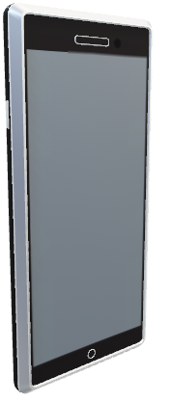
About the app:
This App is named as Stop At Me.
The name makes it interesting as it attracts the interest to know more about it.
So this app basically provides you functionality of playing a game.
This game is about getting a random number and trying our luck and guess to stop at random number we got.
So basically, “Me” represents a random number.

Slide 3
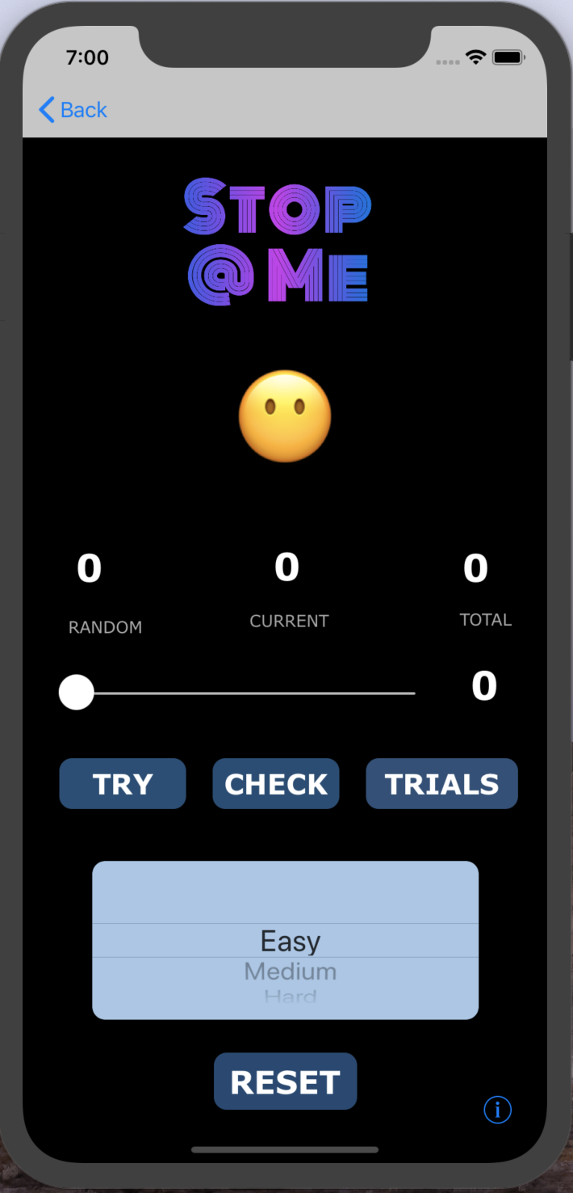
Now let us take you to a visual tour of our game.
Logo
Emoji Graphics
Displays Random Number, Current and Total Score.
Slider Bar and its number generated.
Try, Check and Trails Button to play the game.
Difficulty level
Reset all things.
Info Button

Slide 4
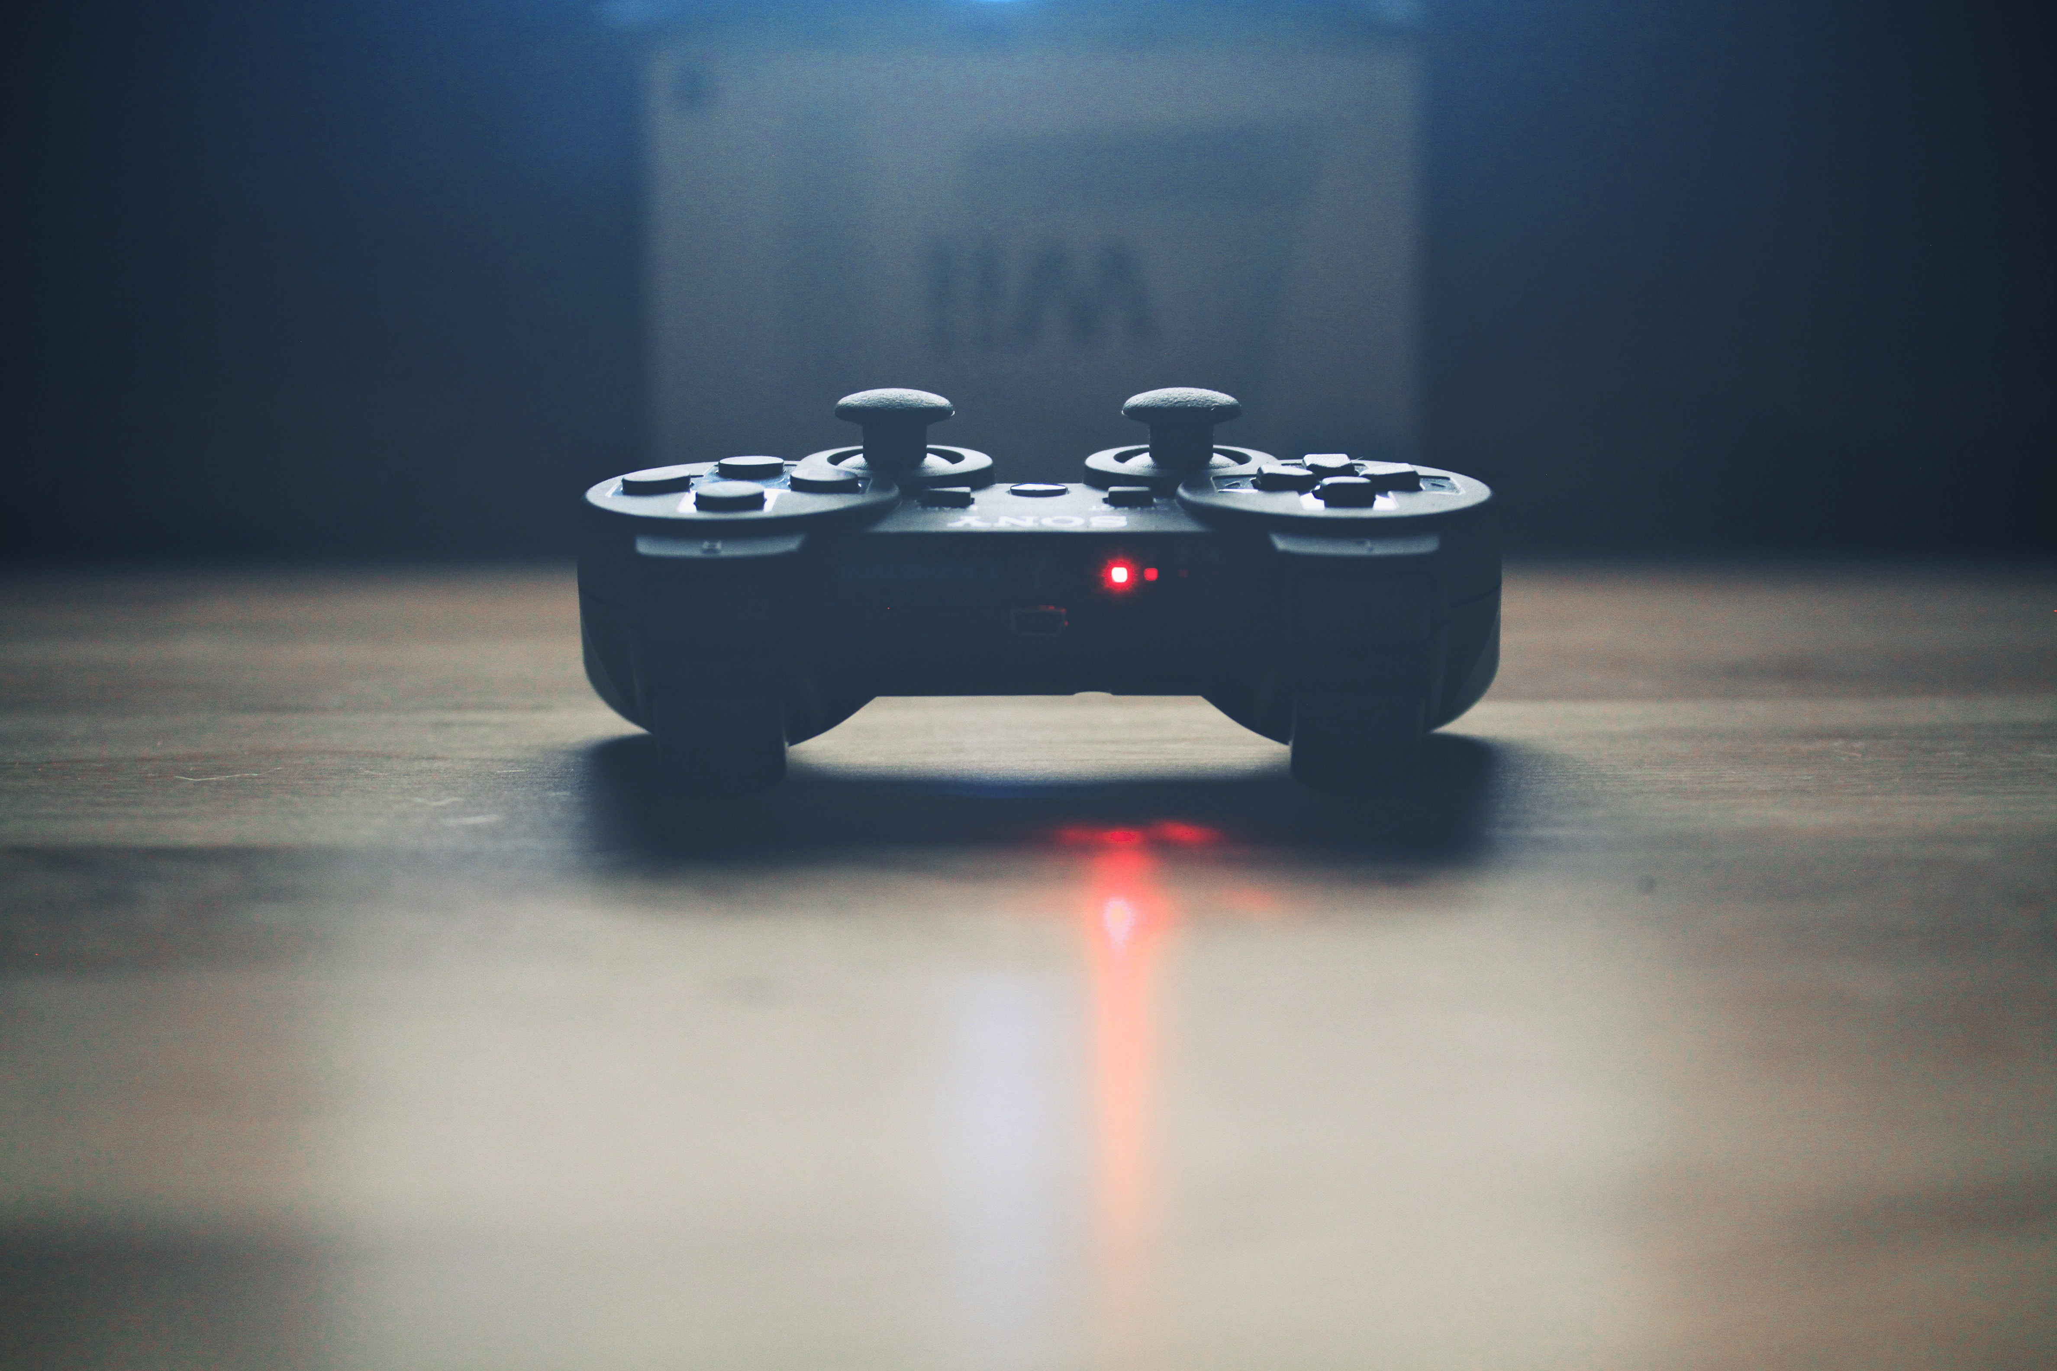
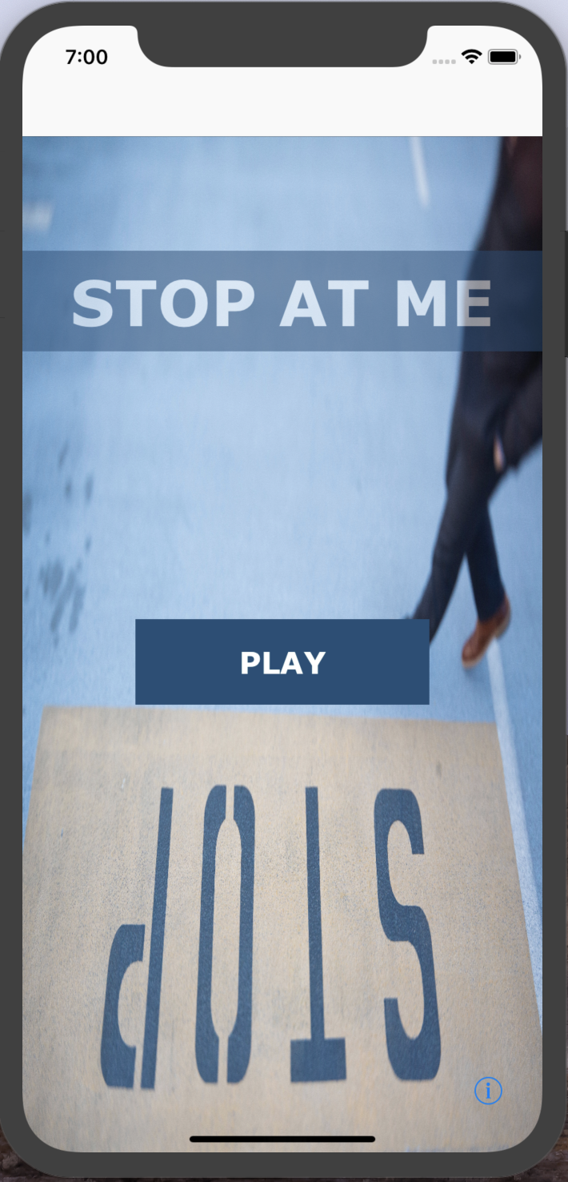
Main Screen:
This is the Main screen.
This screen helps user to navigate to actual game.
At this level, the excitement level may be just 25%.
But there is lot more to explore and we make sure to make excitement level to 100%.
Main Screen

Slide 5
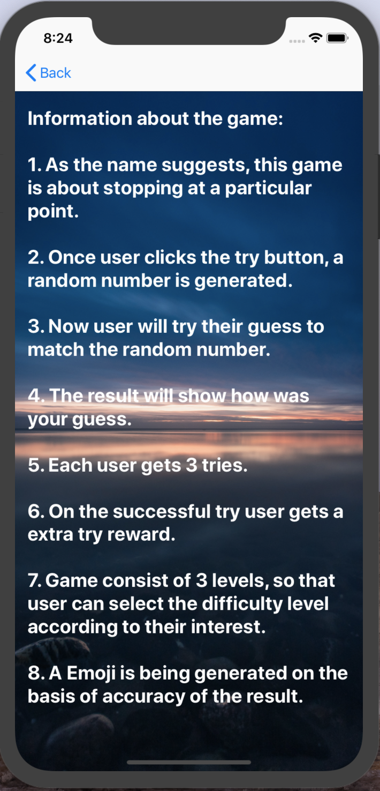
Info Screen:
This is the Info Screen.
This screen helps user to know this game better.
At this level, the excitement level may be increased to 50% (Because, now the features are described).
But there is lot more to explore and we make sure to make excitement level to 100%.
Info Screen

Slide 6
Game play screen:
This is the Game play Screen.
This screen helps user to play game.
At this level, the excitement level may be increased to 75% (Because the features are visible and tempted to use).
But there is lot more to explore and we make sure to make excitement level to 100%.
Game play Screen

Slide 7
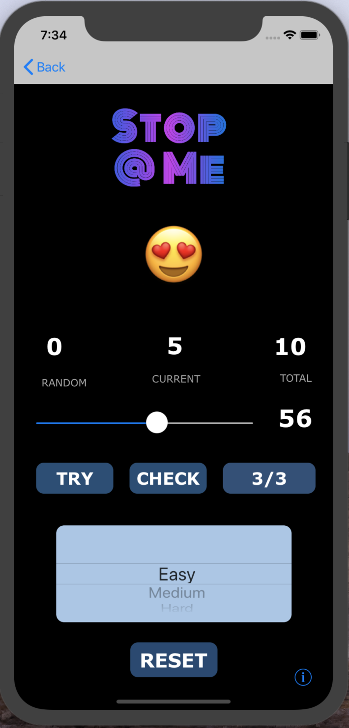
Game play screen:
This is the Game play Screen.
This screen helps user to play game.
At this level, the excitement level may be increased to 100% (Because the features are visible, the different options makes it more exciting).
Now we made sure to make excitement level to 100%.
Game play Screen

Slide 8
Few glances of App:
This features makes this game to be interactive.
The user basically try their luck and guess power to achieve scores.
Now features makes it more interesting by providing (Difficulty level, trails, and graphics representation).
Now game is ready to test the user.

Slide 9
Hope this attracts and tempt you to use this game.
Thankyou

